Slide 1
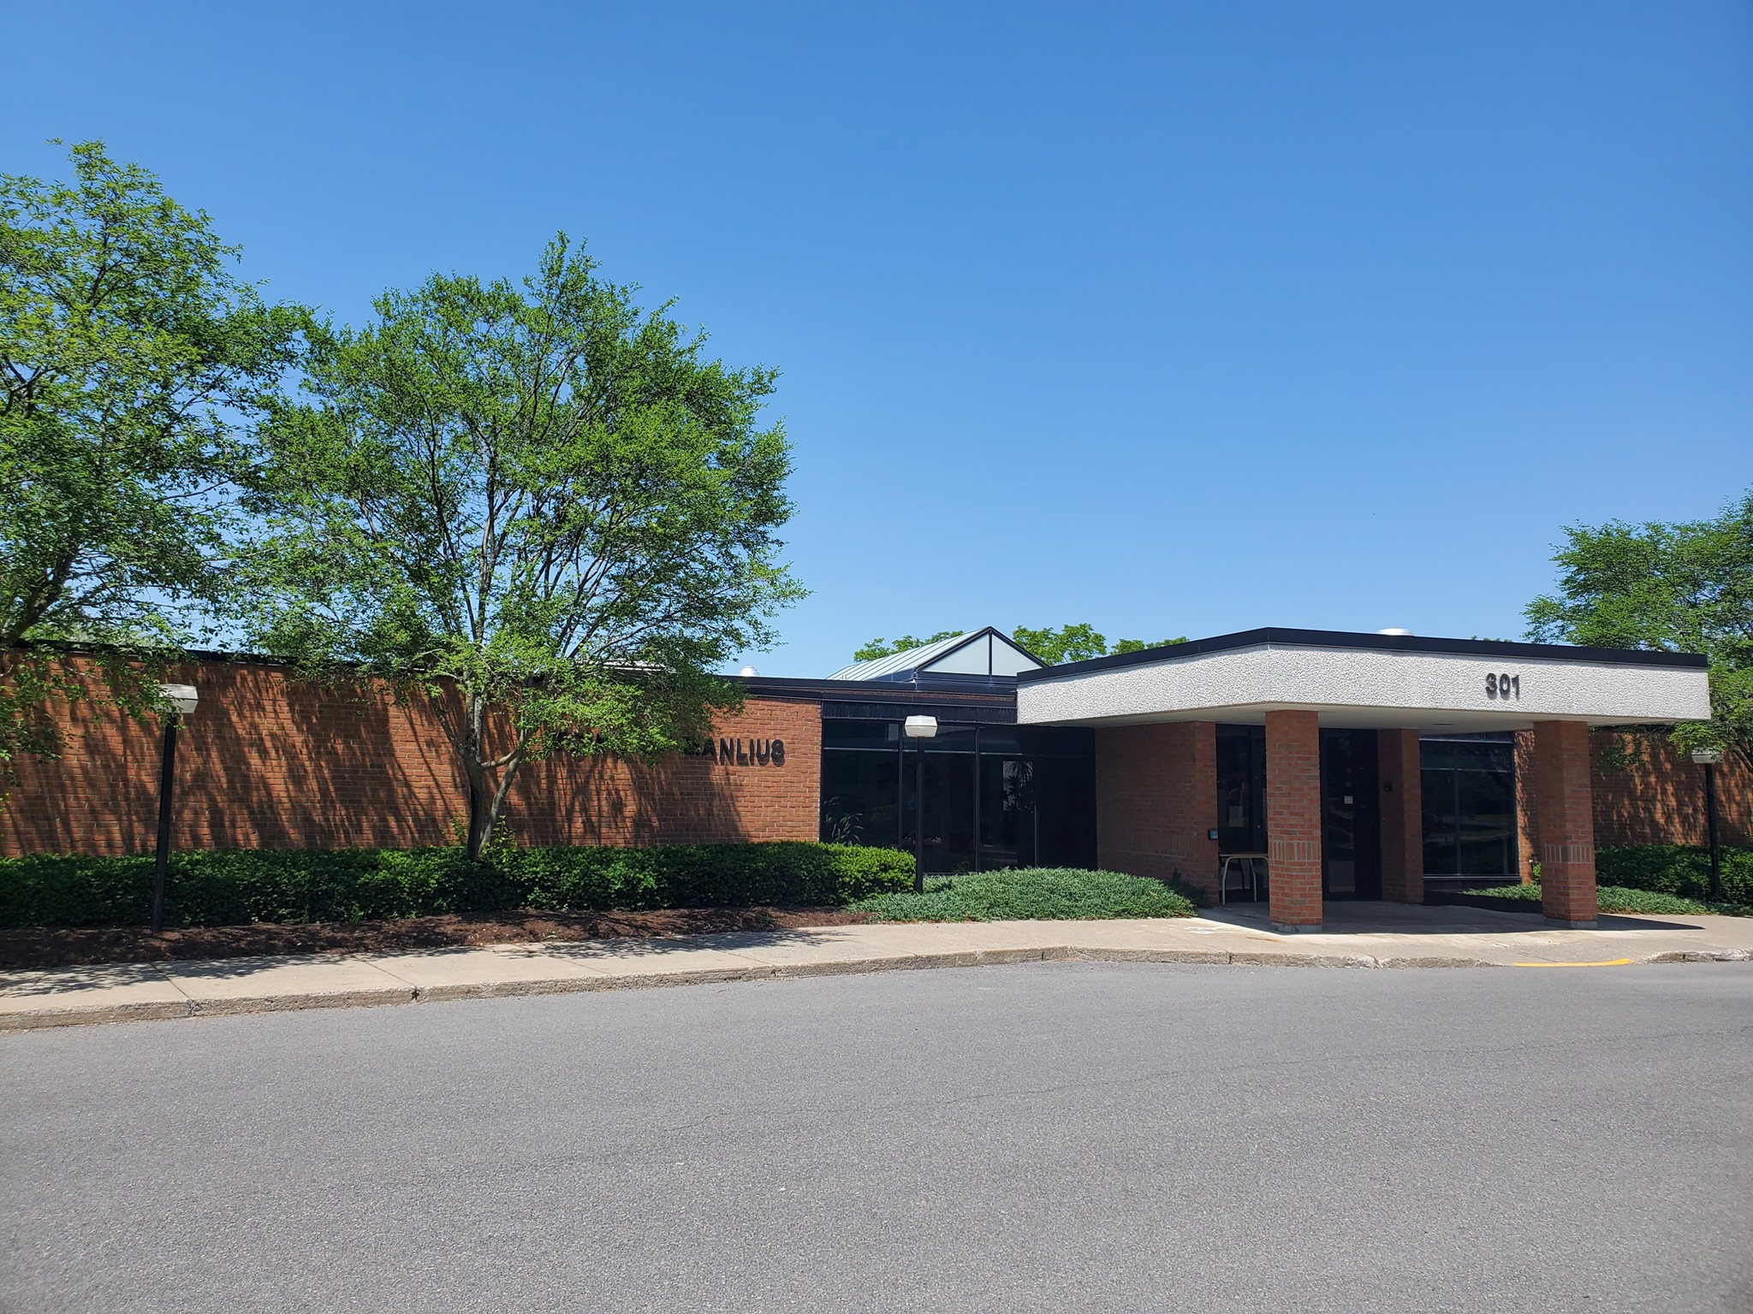
Greenhouse Gas Inventory for the Town of Manlius, New York
Presented by,
Atif Ali, Addison Molinaro, and Cooper Pyle

Slide 2
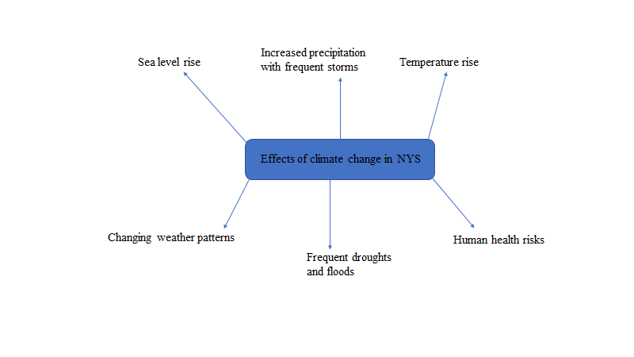
Climate Change Effects in New York State
https://www.dec.ny.gov/energy/94702.html
Notes:
Cooper

Slide 3

Climate Smart Community Certification Program
Climate Smart Communities (CSC) is a New York State program that helps local governments take action to reduce greenhouse gas emissions and adapt to a changing climate.
https://climatesmart.ny.gov/
Notes:
Cooper

Slide 4
Purpose of Greenhouse Gas (GHG) Inventory for Manlius-2019
Calculate GHG emissions from the selected sectors
Identify ways to reduce GHG emissions
Manlius can become a certified Climate Smart Community
Notes:
Addison

Slide 5
Methods
EPA Local Greenhouse Gas Inventory tool and ICLEI protocol were used to calculate GHG emissions for the year 2019. The following three sectors are included:
a)Buildings and facilities
b)Streetlights
c)Vehicle fleet
Notes:
Atif

Slide 6

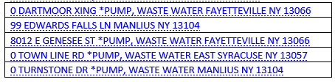
Methods Cont’d and Data Exclusions
All pump stations have been turned over to Onondaga County as part of the sewer consolidation so the following accounts were removed from this study.
Notes:
Atif

Slide 7
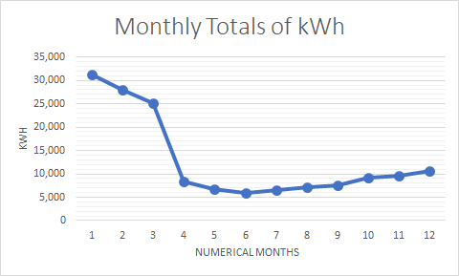
Streetlights - Findings and Graph
Total annual energy consumption is 160,390 kWh
18.49 MT CO2e emissions
Notes:
Addison

Slide 8
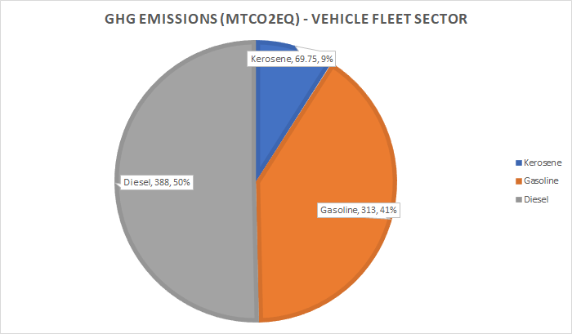
Vehicle Fleet Sector - 2019 Emissions
Notes:
Atif

Slide 9
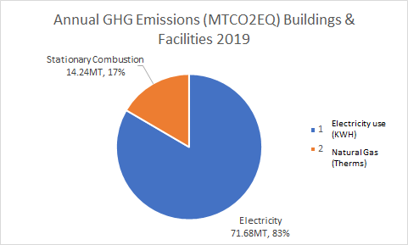
Buildings and Facilities - Graph

Slide 10
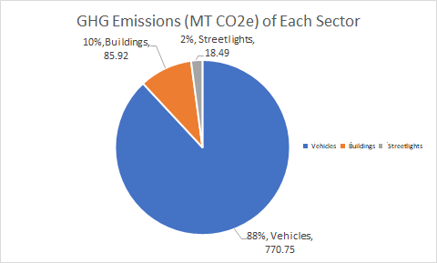
Total Emissions of Manlius in 2019
Vehicle fleet - 770.75 MT CO2e
Buildings and facilities - 85.92 MT CO2e
Streetlights - 18.49 MT CO2e
Notes:
Addison

Slide 11
Discussion
Total emissions for 2019 year - 875.16 MT CO2e
Vehicle fleet - 88%
  Diesel 50% in VF
Buildings & facilities - 10%
Streetlights - 2% (winter>)
Notes:
All

Slide 12
Recommendations
Electric Vehicles (zero emissions)
Natural gas vehicles (11% GHG reductions)
Alternative renewable fuels - biofuels
  Ethanol 85 - 34% GHG reductions
  Biodiesel 20 - 20% GHG reductions
Investing in building improvements
  Energy audits to assess areas of improvement
  Energy efficient windows
  Upgraded insulation
https://afdc.energy.gov/
Notes:
All

